Slide 1
Lending Club Case Study Submission
Submitted By :
Yoshita Dhanwaria
Kasi Viswanadh

Slide 2




Problem Statement & Key Objectives
Business Objective:
To understand about the drivers of “Default” to quantify the credit risk corresponding to the loan applications. Aiming to minimize the credit loss for the consumer finance company
Data availability: Consumer and loan attributes
Constraints:
No transactional information available for the applications that were rejected as lending didn’t happen in such cases
The driver analysis needs to be done using “EDA”, i.e., without resorting to any modeling techniques
Assumptions :
“Charge off” or “Write off” are synonymous to Default. Usually, when the delinquency past due (DPD)
status for applicants move beyond a certain cut-off or threshold, per the regulatory requirements, the lender needs to
declare such cases as “Losses” in their P&L accounts which is why it is called writing the loan off the books. The
regulatory requirements for writing off loans may differ across portfolios and geographies

Slide 3
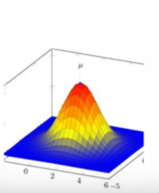




Analytical approach
Data cleaning
Data quality checks
Data formatting and manipulation
Dimensionality reduction
Univariate Analysis
Distributions
Frequency tables
Additional variables
Segmented univariate analysis
Key metrics across various variable segments
Derived variables
Inputs for bivariate analysis
Bivariate Analysis
Correlation analysis
Cross Frequency distribution analysis
Joint distributions
Conclusion
Combine the results from the analysis
Actionable insights for the executive team

Slide 4

Data Cleaning / Preprocessing
Dataset has 39,717 observation and 111 variables
There are 54 columns which having more than 100% NULL
There are 9 columns which are having only one unique value
We don’t have any duplicated rows in the dataset
revol_util & int_rate fields have ‘%’ symbols, and we have treated this variable in code
emp_length clearly filed have "<" & “+”symbols and we have treated this variable in code
issue_d, earliest_cr_line, earliest_cr_line, next_pymnt_d, last_credit_pull_d, last_pymnt_d are data variable, and we have changed the data type for them to datetime.
'emp_title' , 'desc' ,'url' ,'title','zip_code’ has too many values and won't be useful for data analysis hence we have dropped them.
'mths_since_last_record', 'next_pymnt_d’ has 90% value as missing hence dropped them

Slide 5
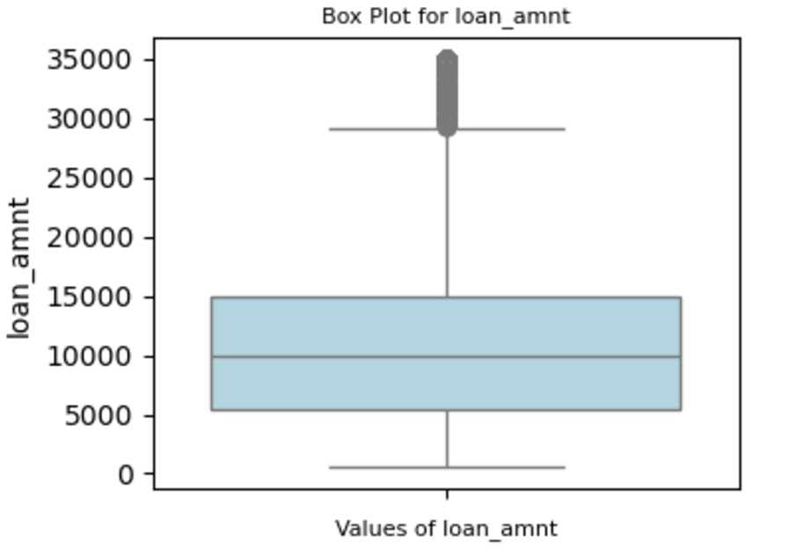
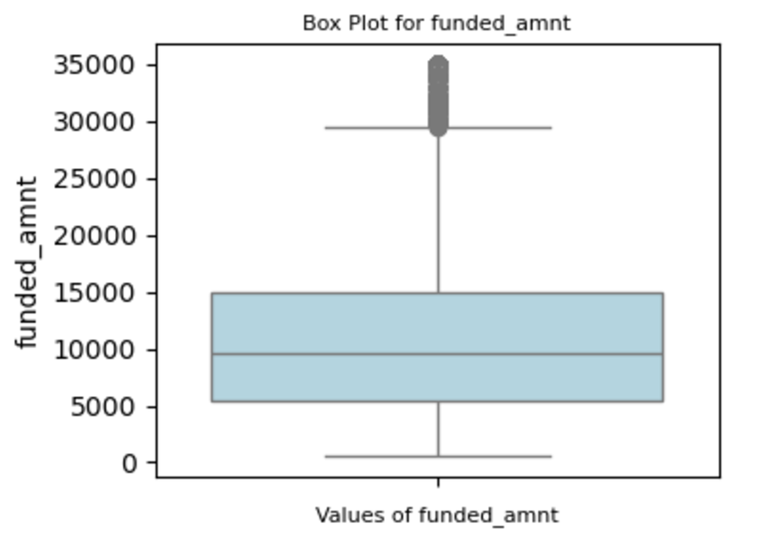
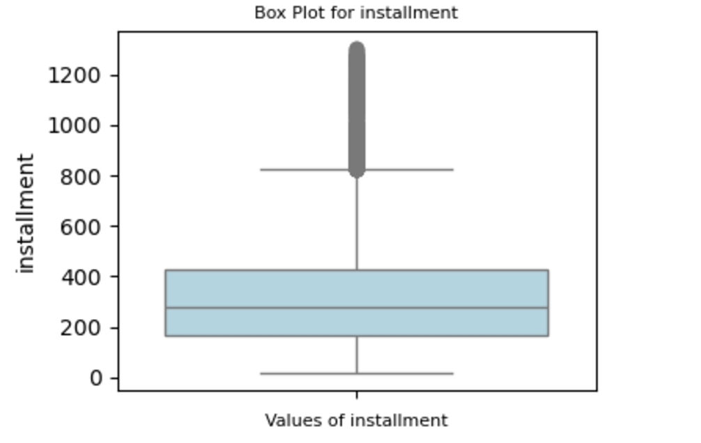
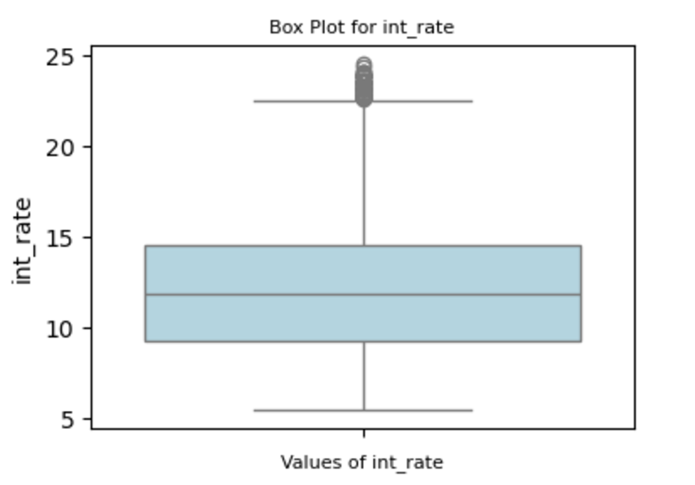
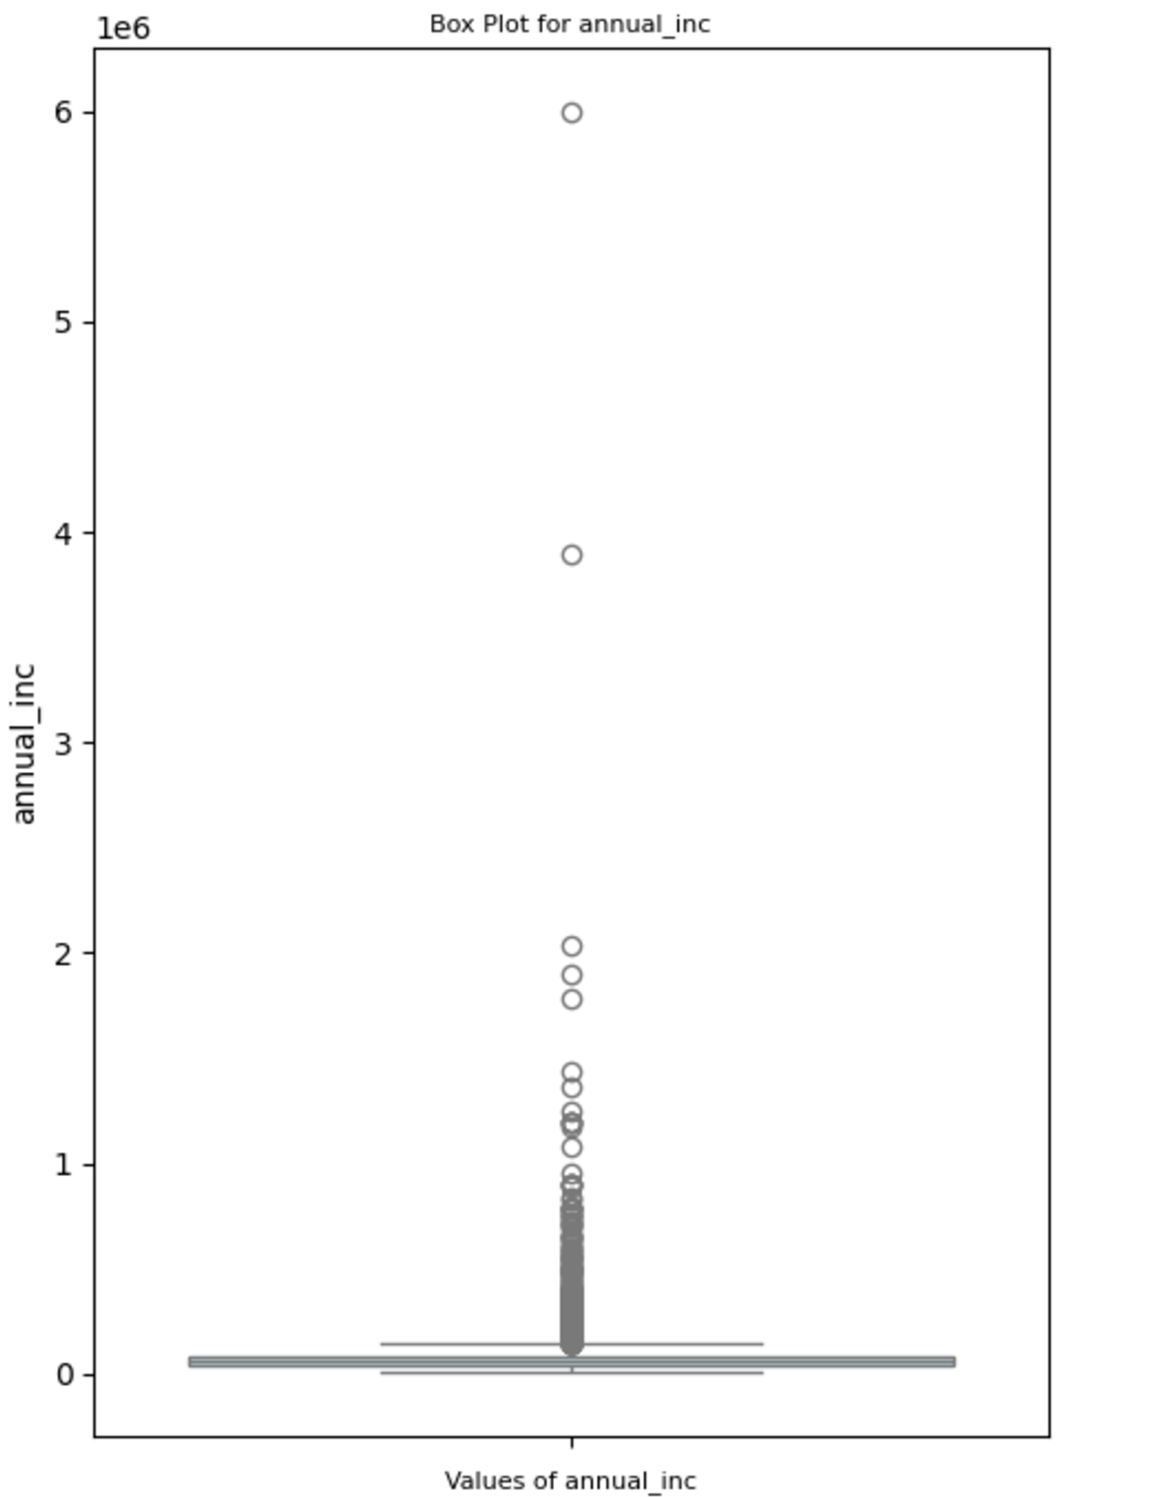
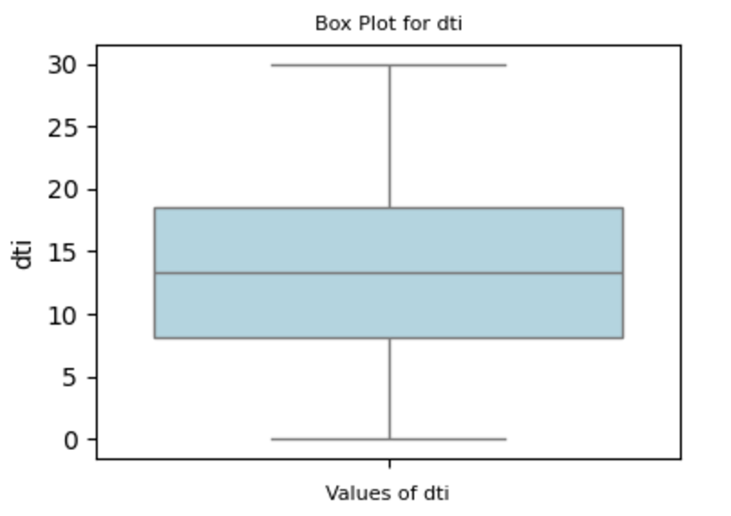
Quantitative variables Analysis
The annual income of most of the loan applicants is between 40,404 - 82,300
The loan amount of most of the loan applicants is between 5,500 - 15,000
The funded amount by investor for most of the loan applicants is between 5,400 - 15,000
The interest rate on the loan is between 9.25% - 14.59%
The monthly installment amount on the loan is between 167 - 430
The debt-to-income ratio is between 8.17 - 18.60

Slide 6
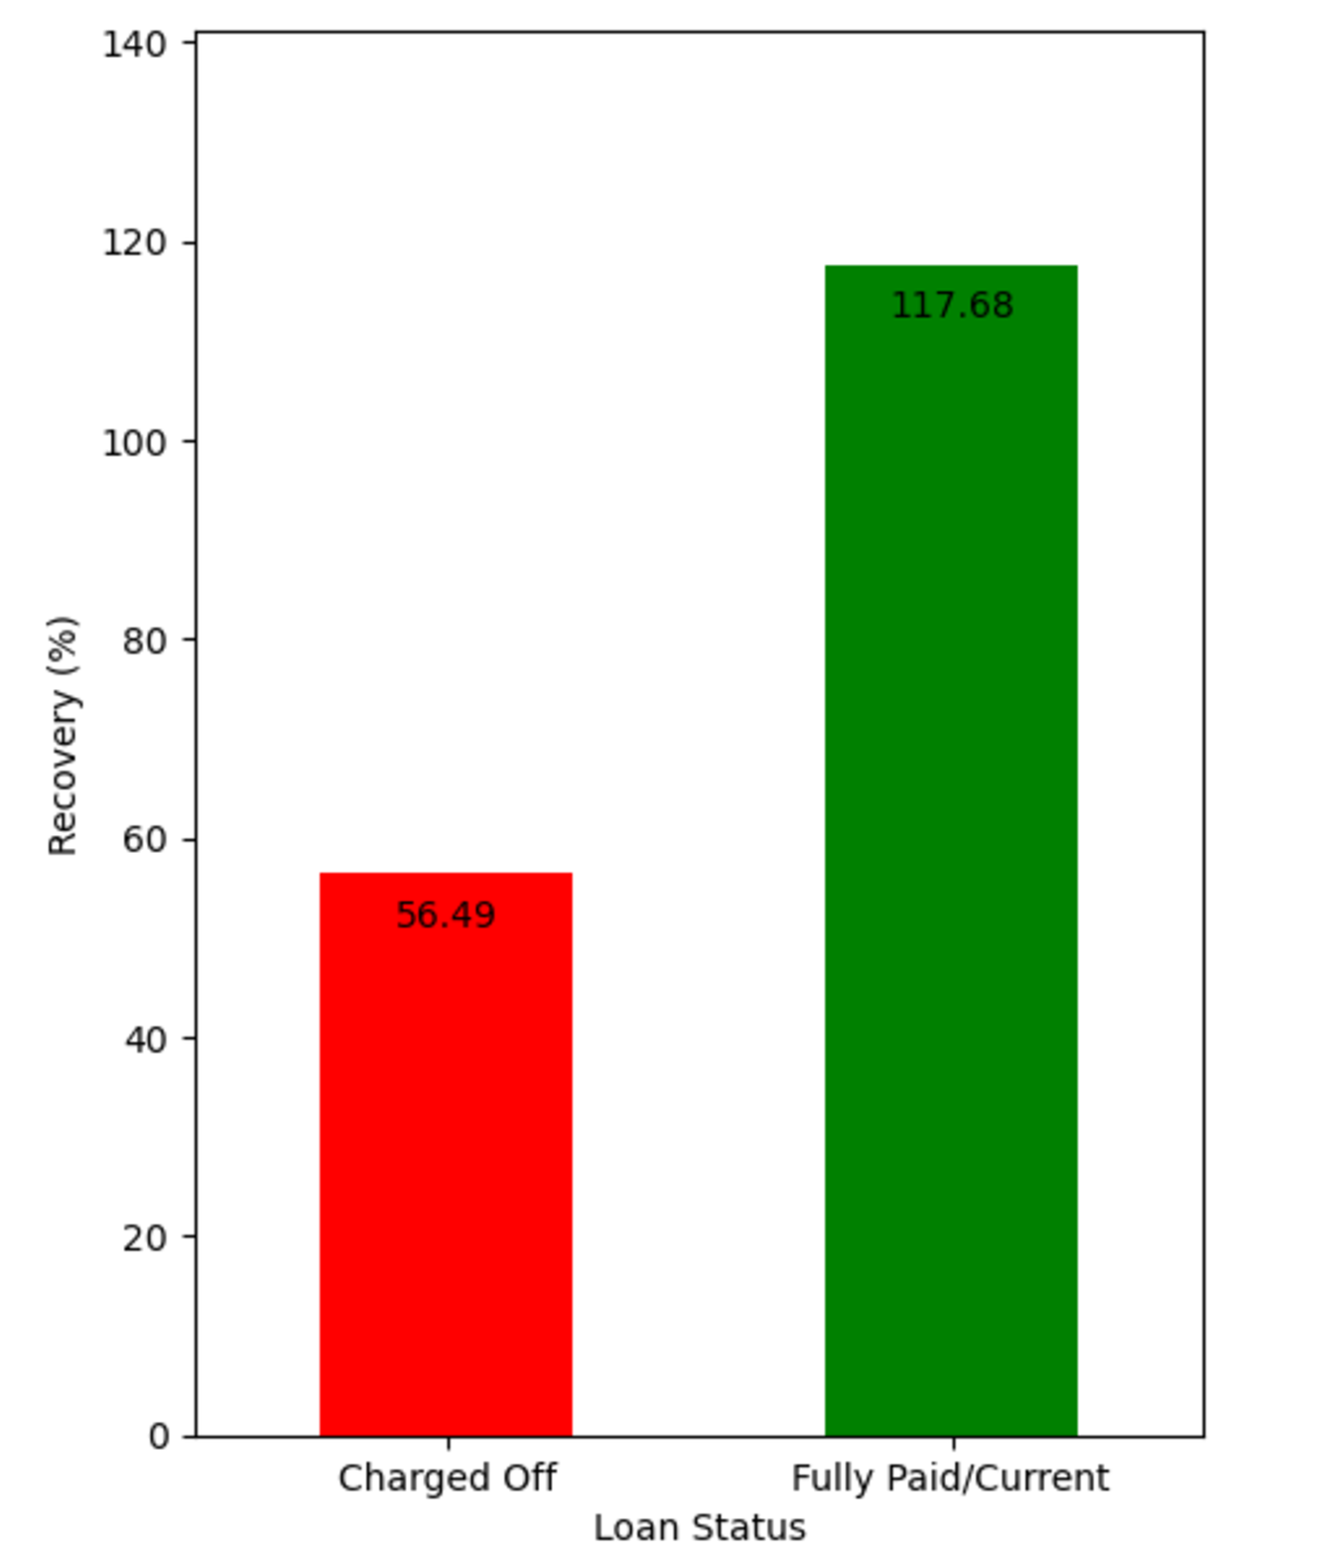
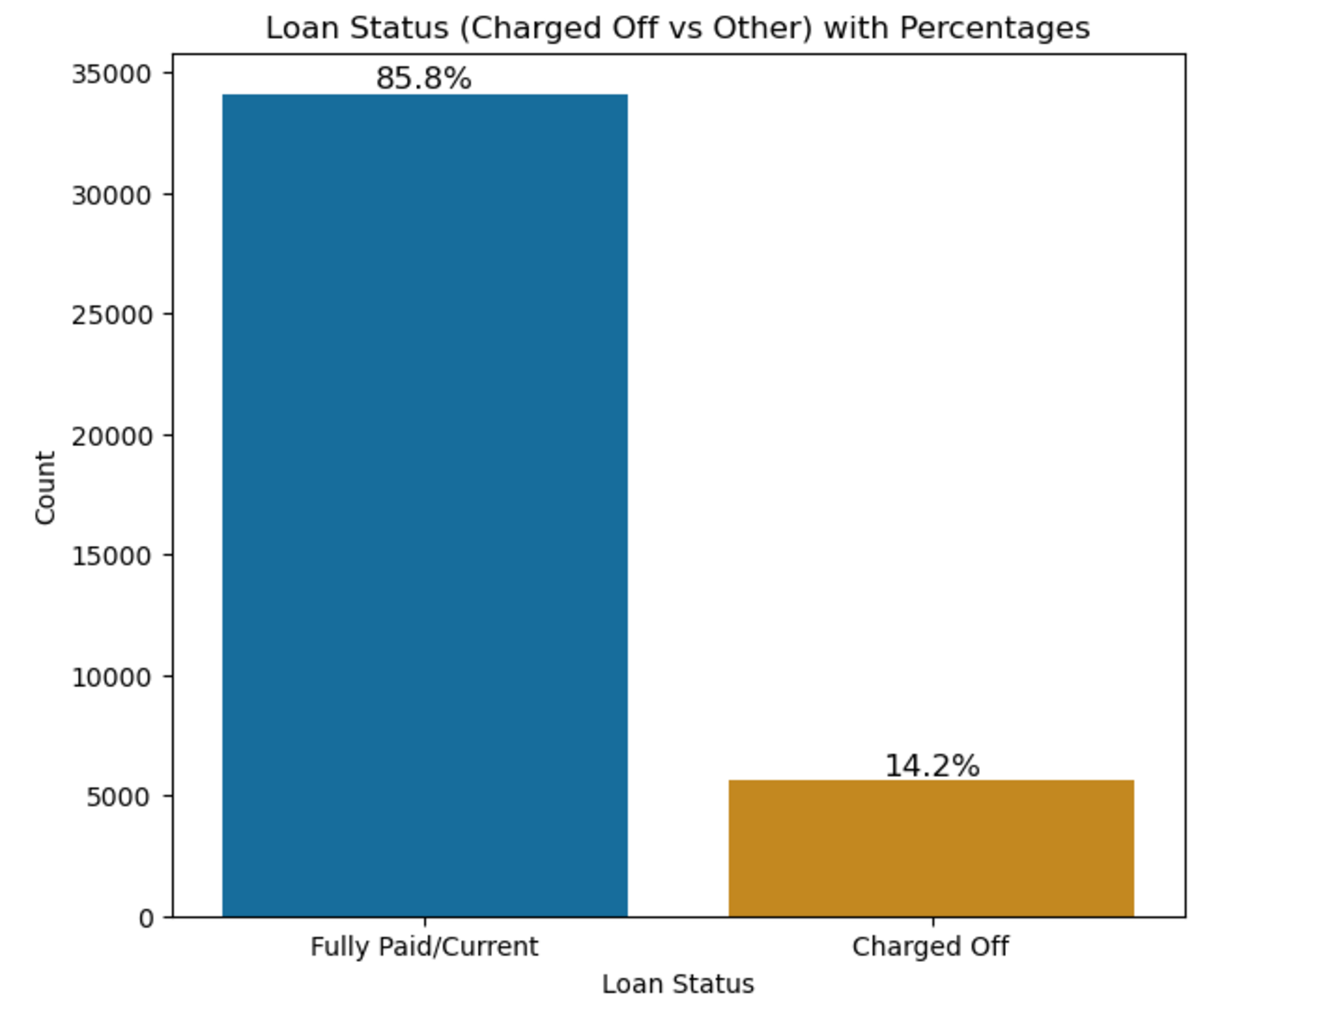
Defaults & recovery
The default rate of the portfolio is ~14%
Only ~56% of the loan amount is recovered from the defaulters

Slide 7
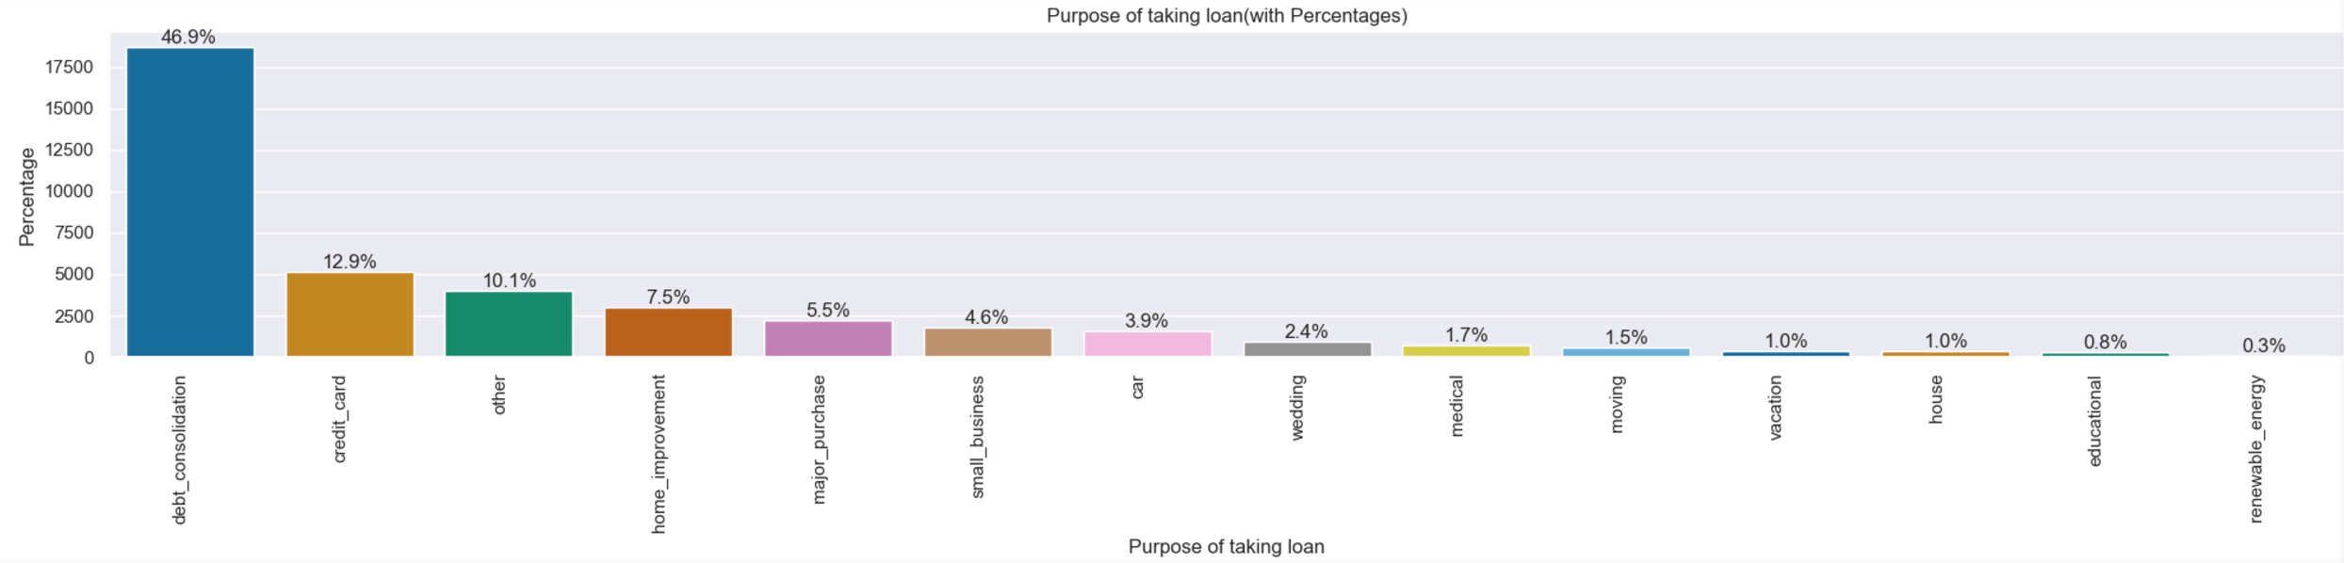
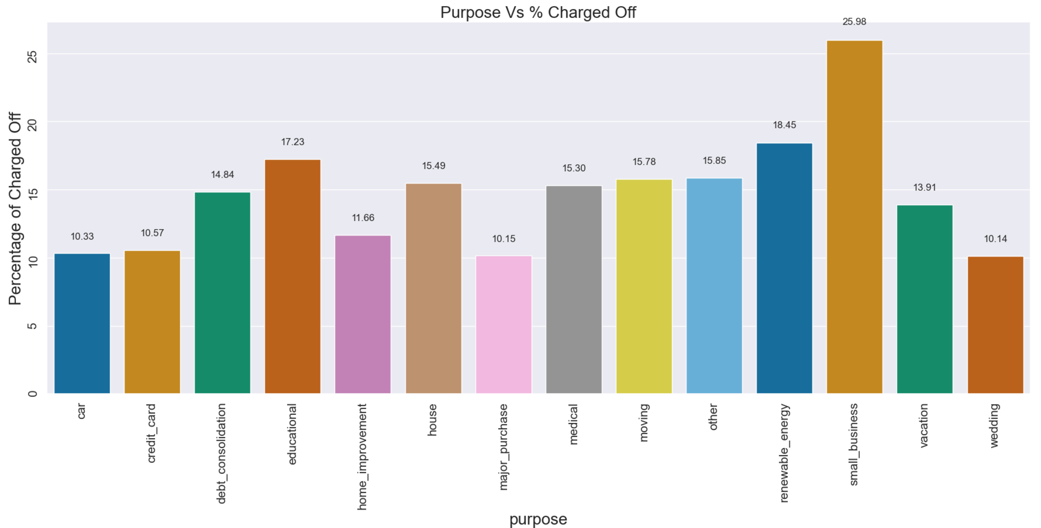
Purpose & riskiness
~47% loans’ purpose is Debt consolidation followed by Credit Cards at ~13%
Small business loans seem to be the riskiest while wedding loans have least defaults

Slide 8
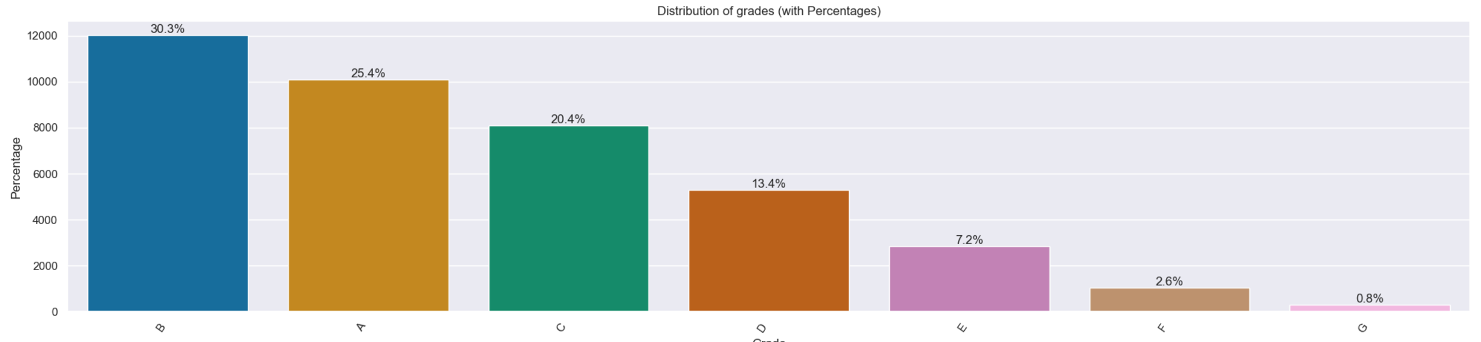
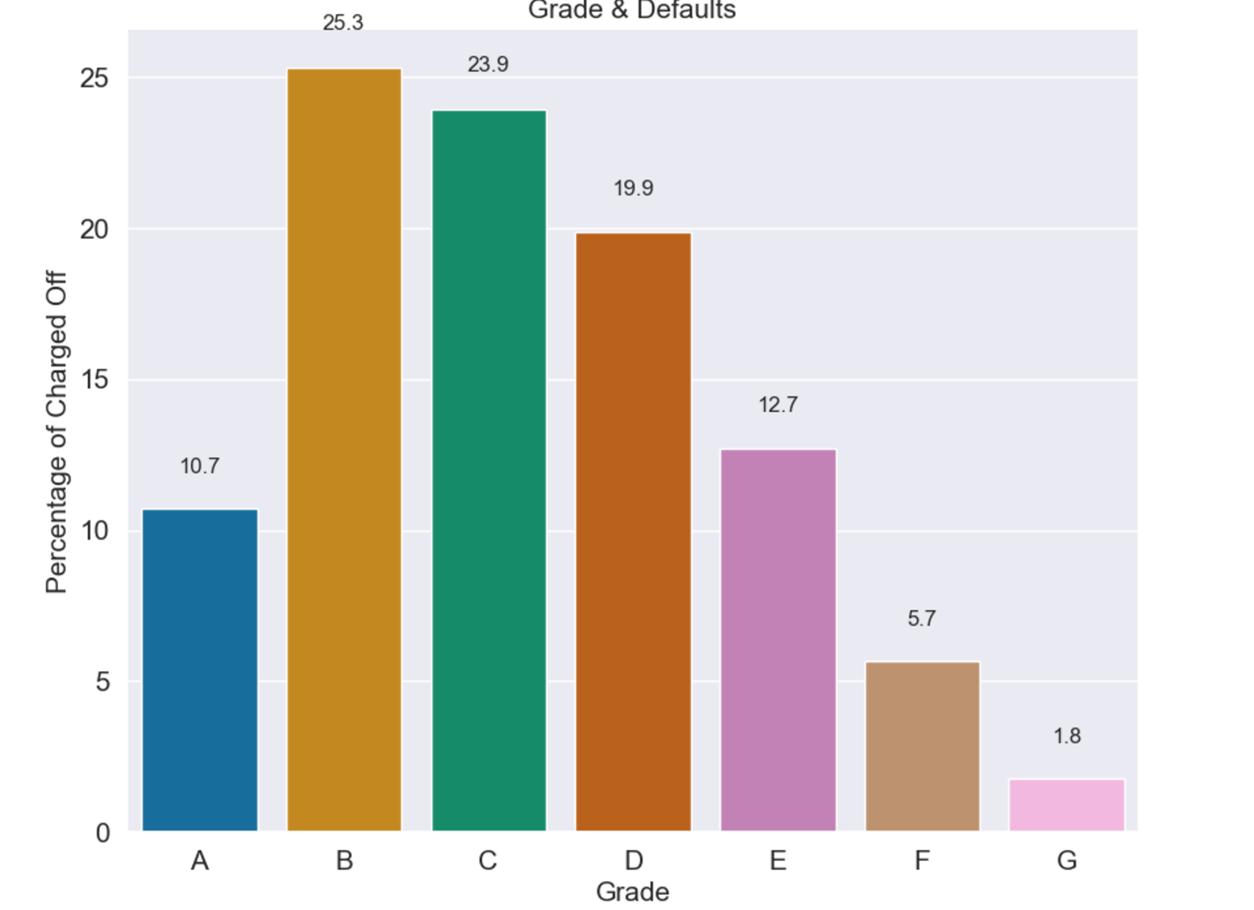
Grade
~30% loans belongs to grade B followed by grade A at ~25%
45 % of defaulters belong to grade B & grade C

Slide 9
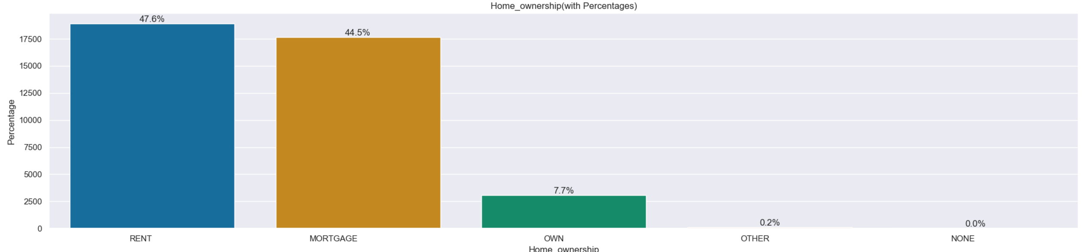
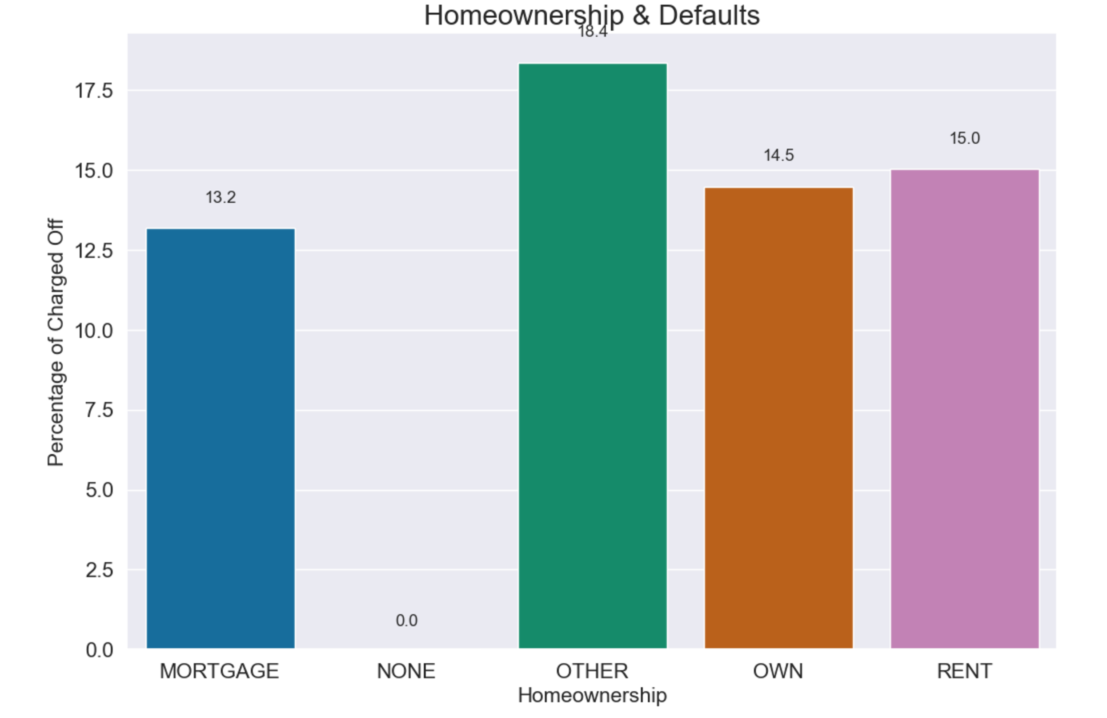
Homeownership
~47% loans belongs to people staying in rented house followed by mortgage at ~45%
~18 % are defaulters in others category

Slide 10
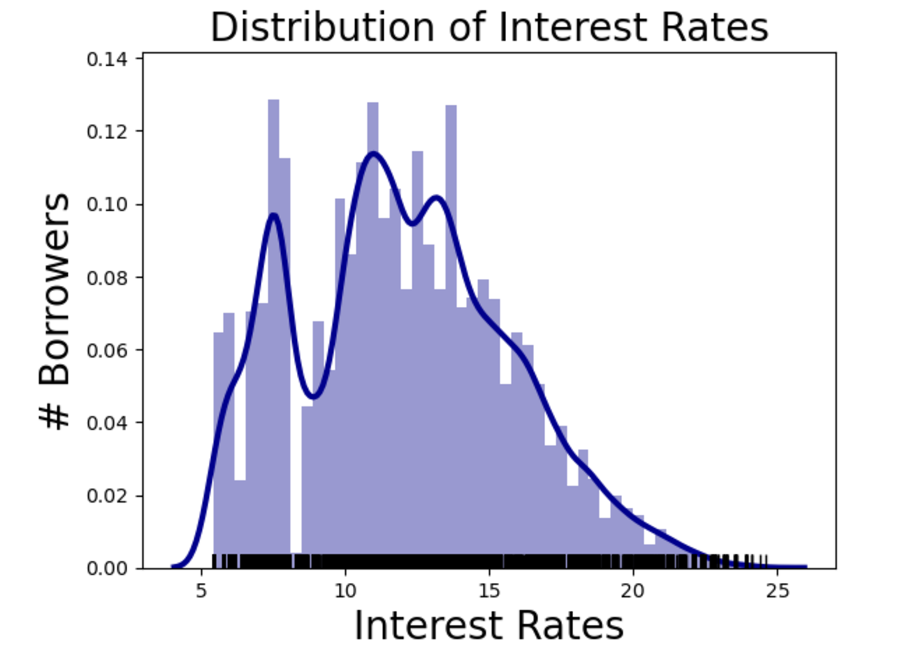
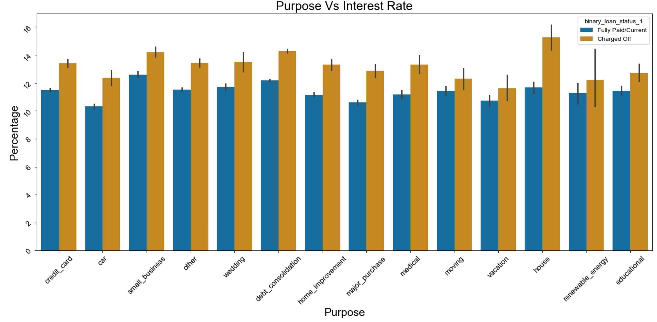
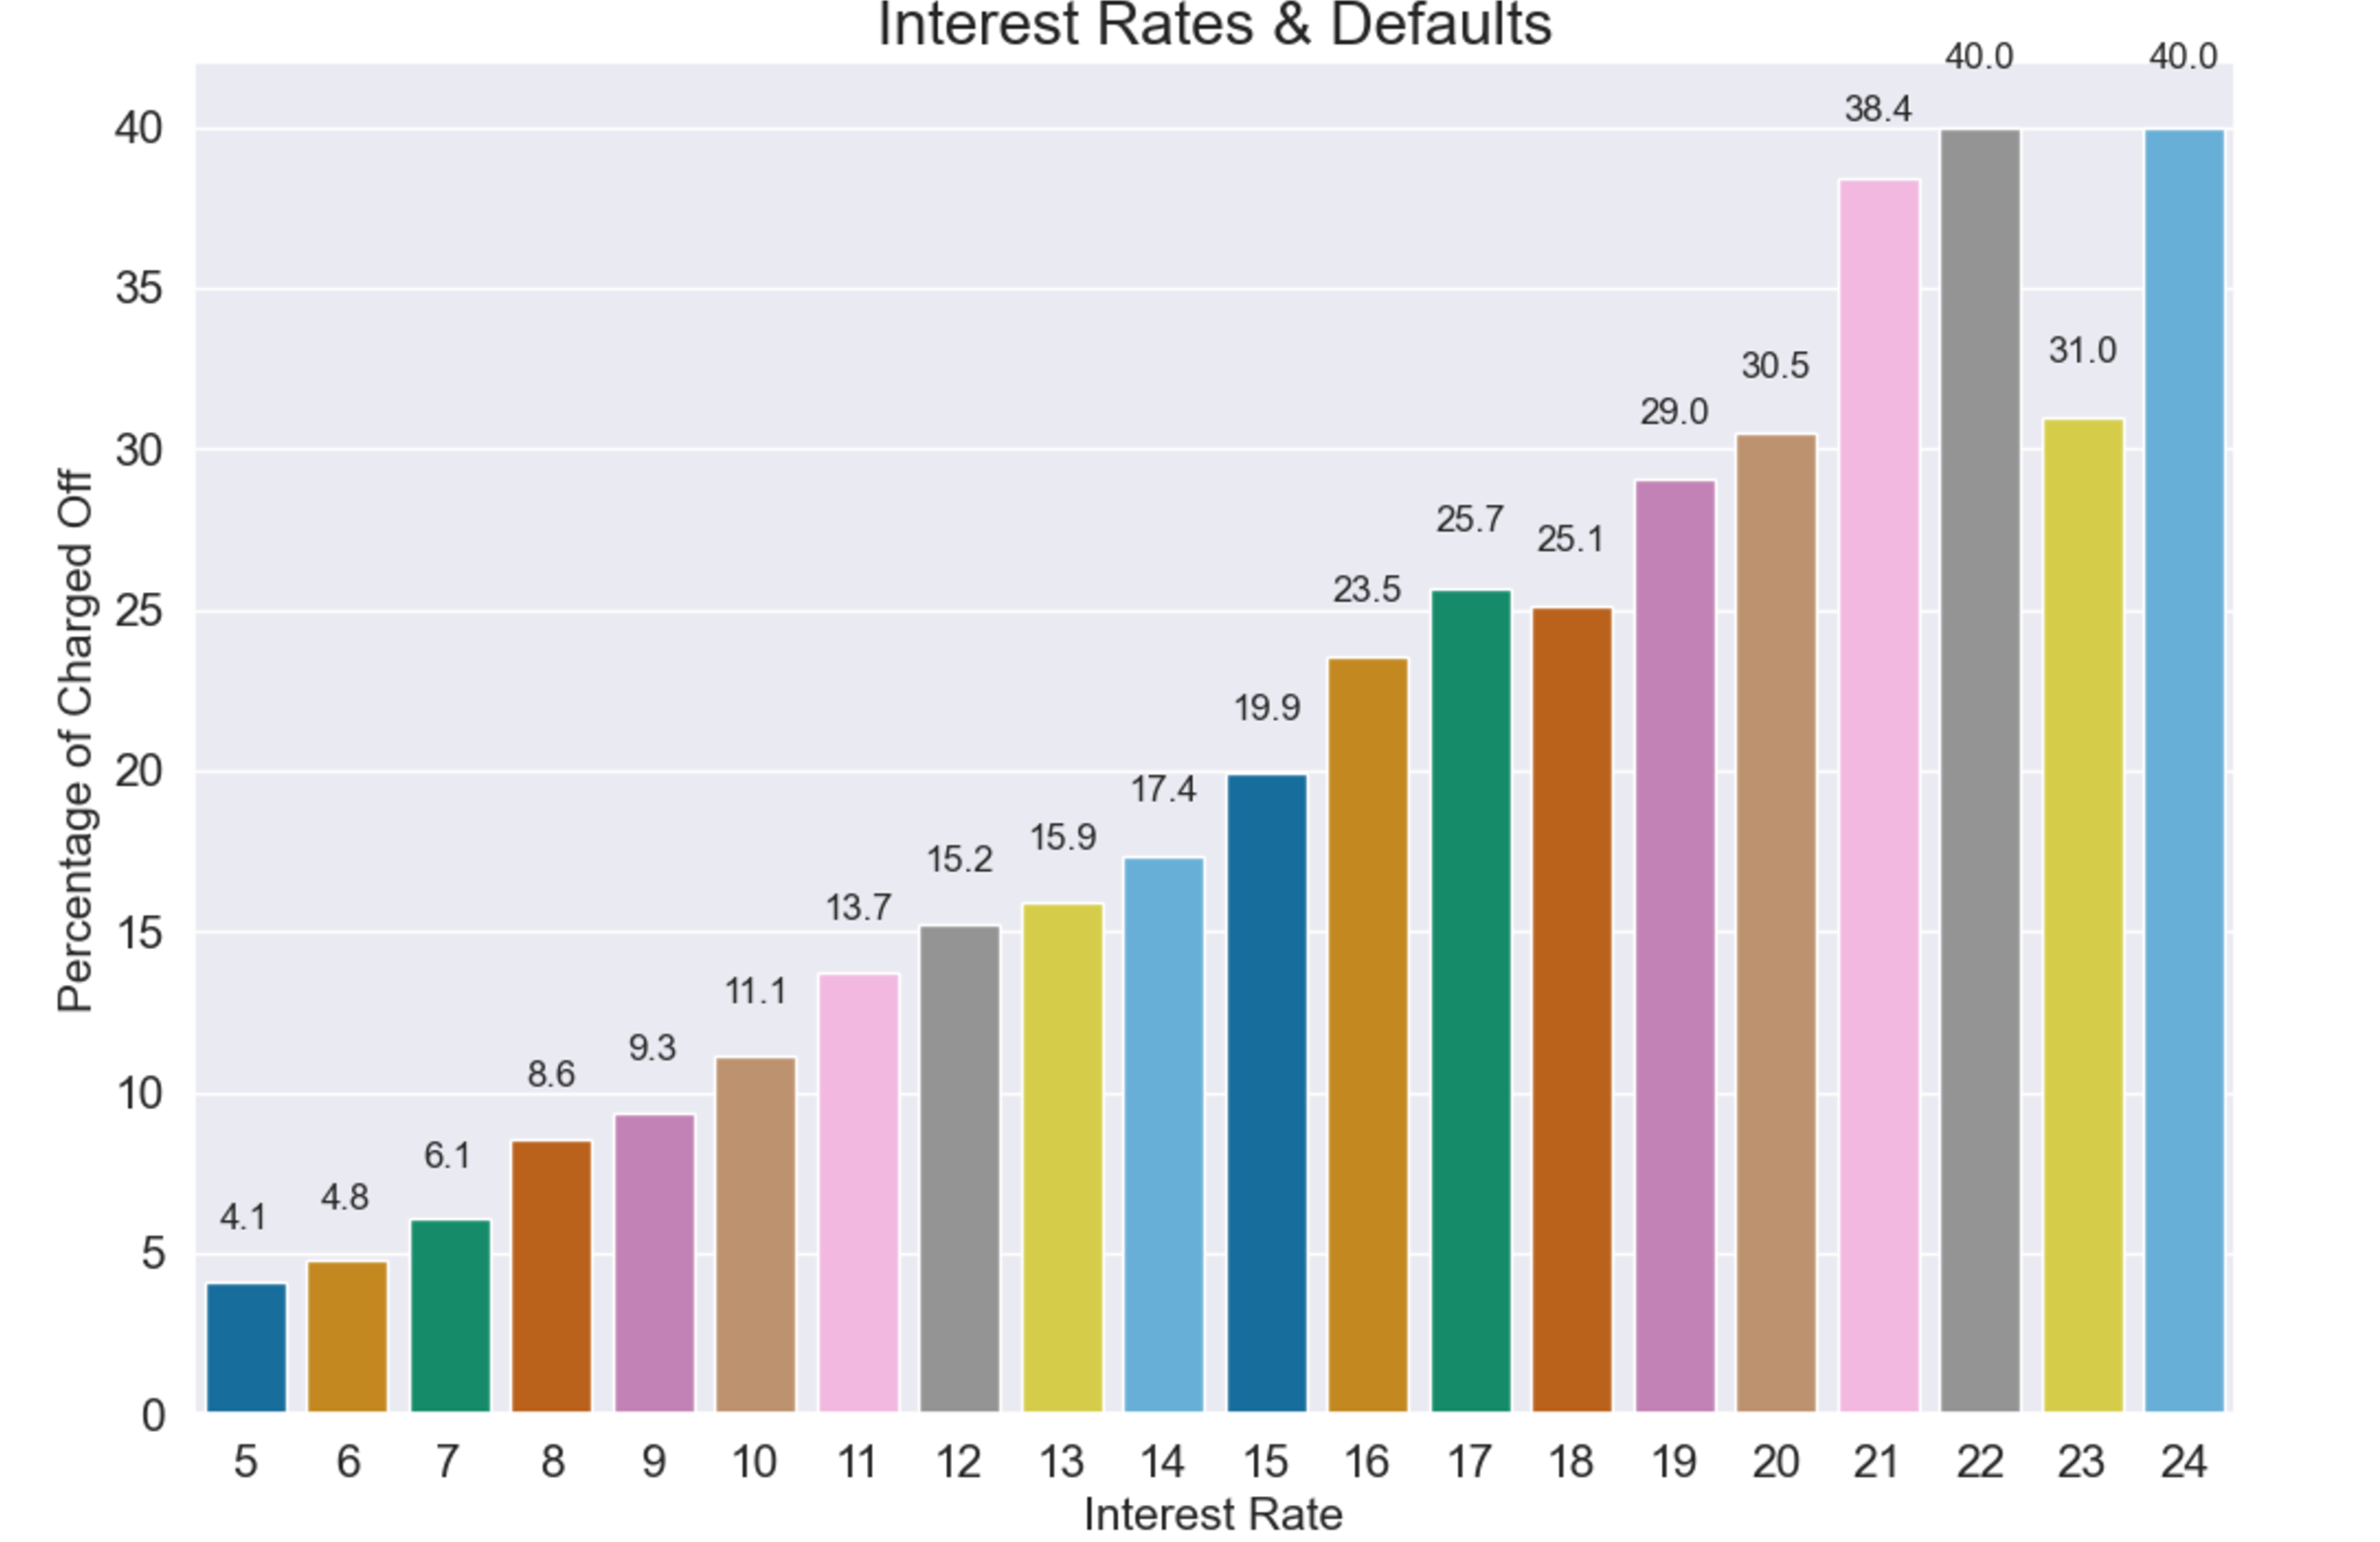
Interest rates
The default rates increase significantly as lending rate increases
This also implies that the lender is assessing the risk correctly which is why a risk premium is being added to the lending rate

Slide 11
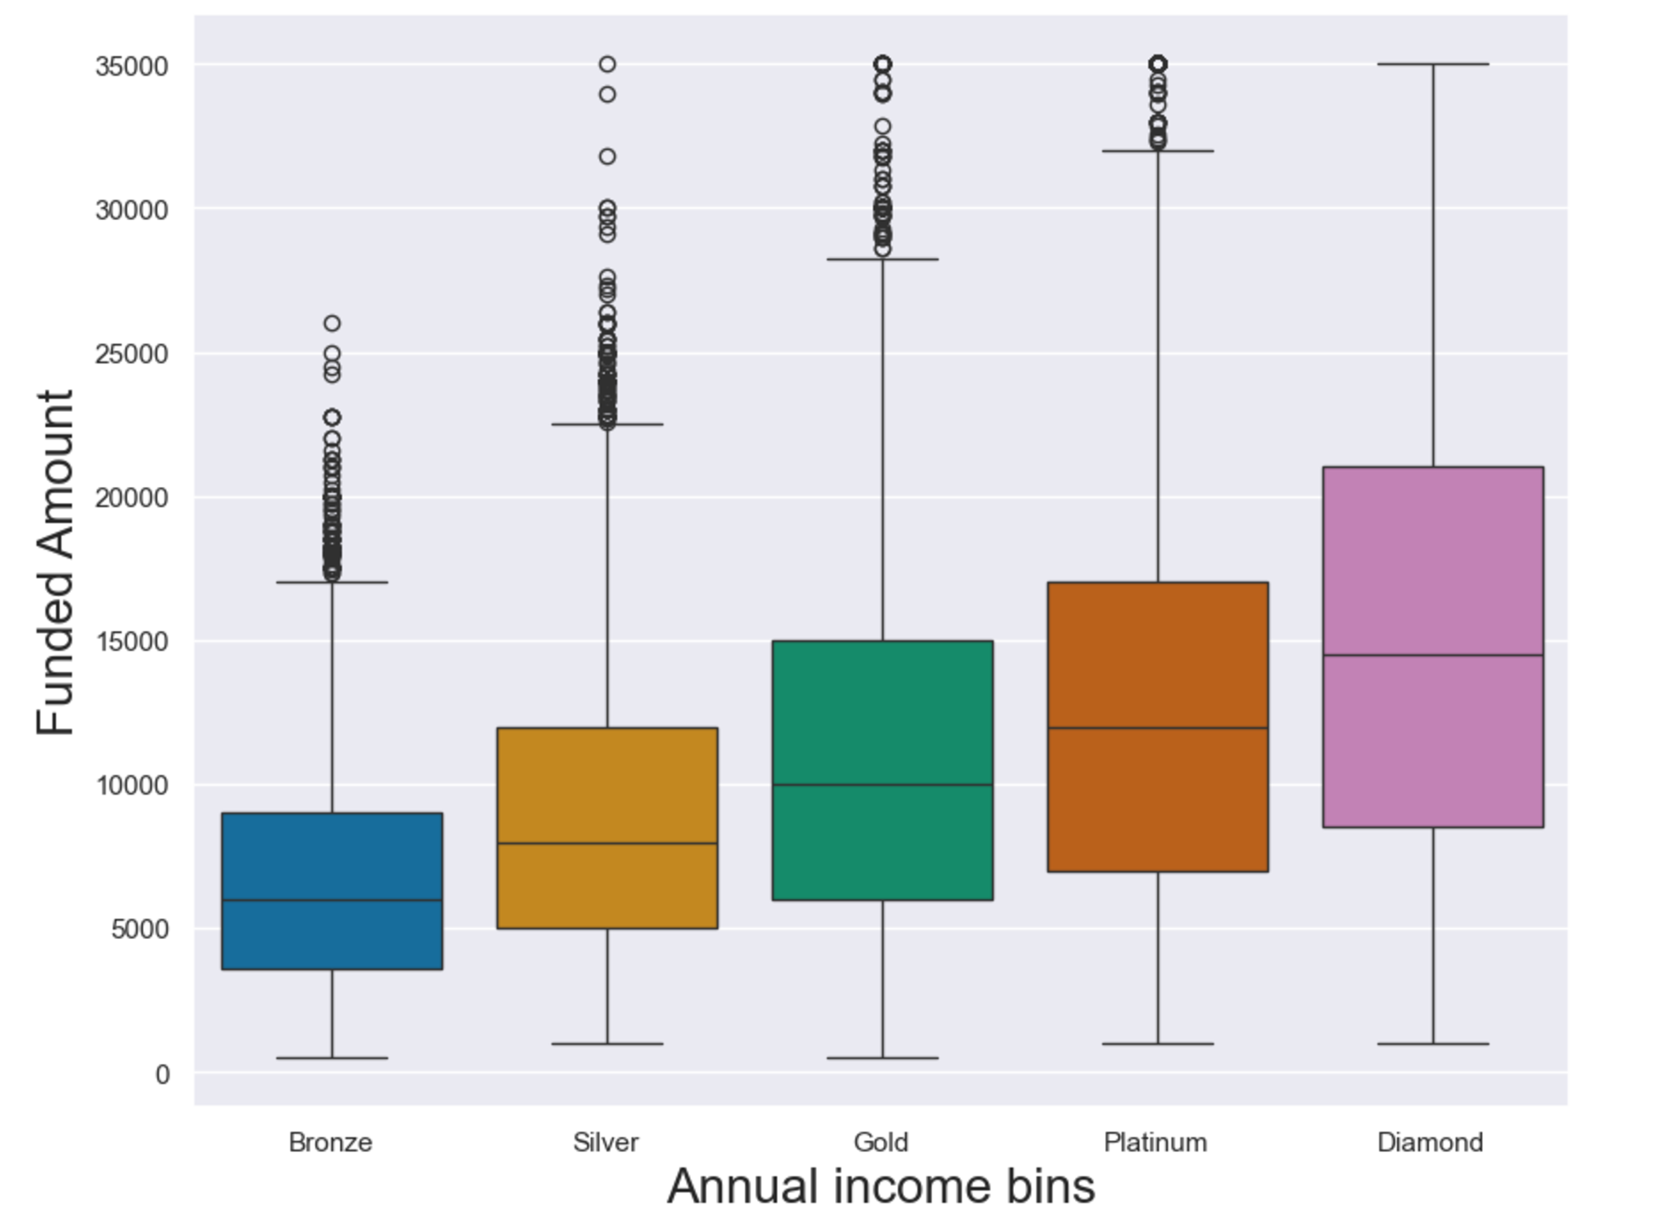
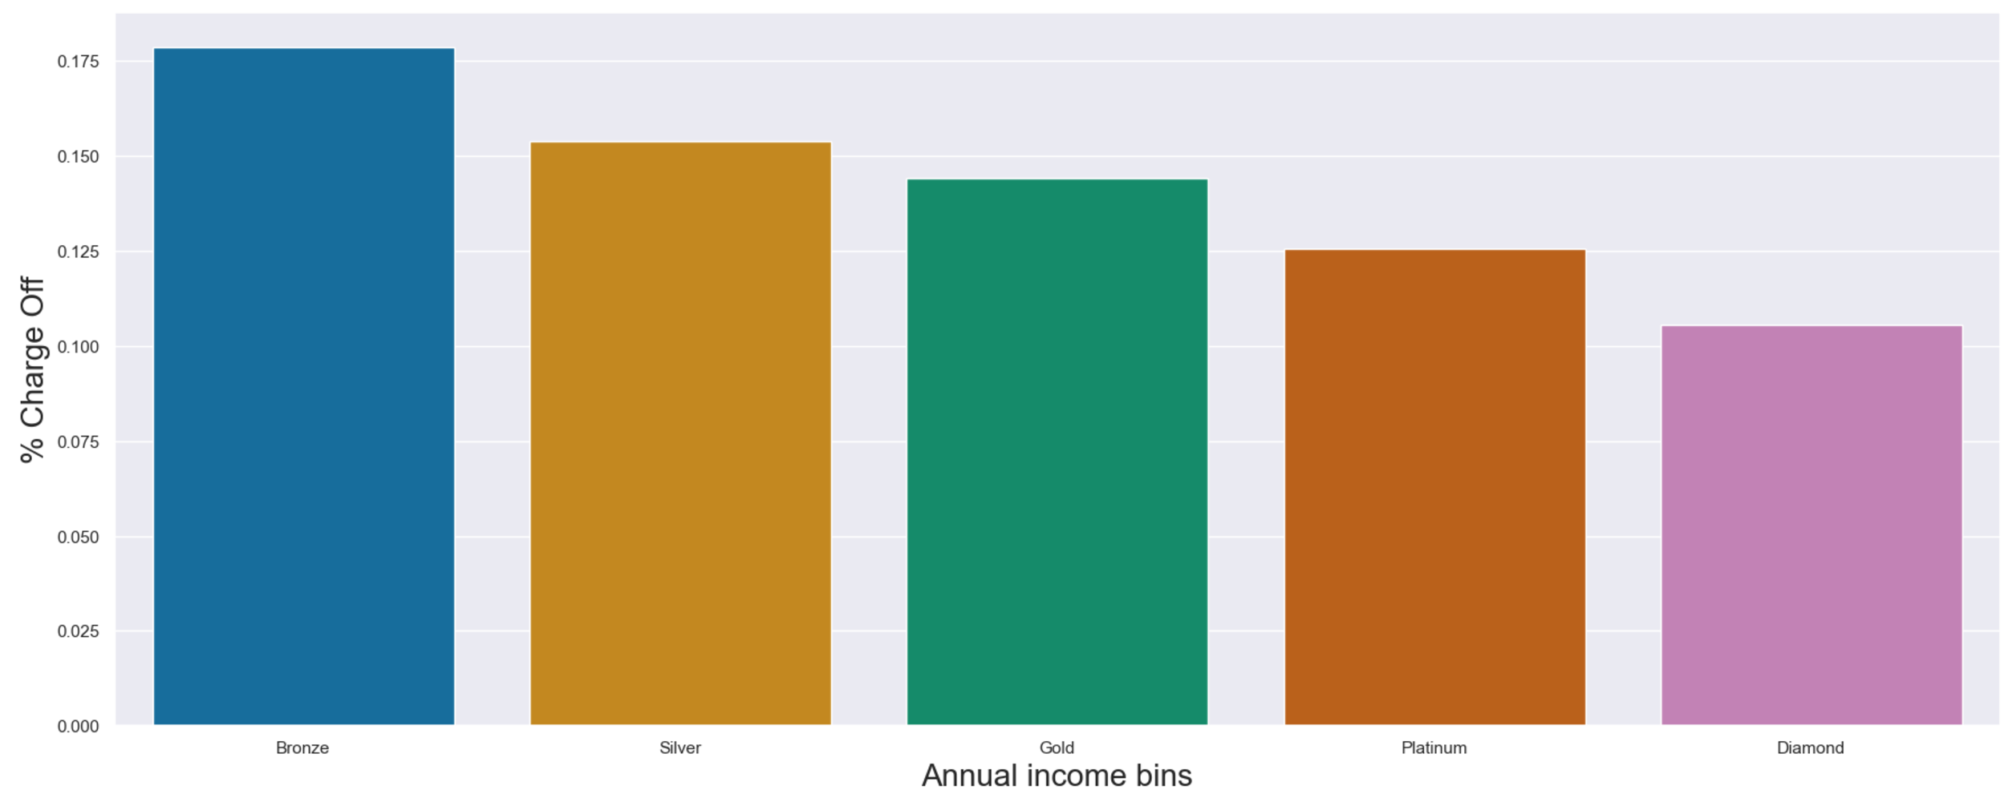
Annual income buckets and funded amount : Defaults
Assessing the variation in annual income of borrowers, we created homogenous income bins
The funded loan amount increases with the increase in annual income, probably high-income borrowers are perceived less risky
Higher income brackets correspond to lesser default rates
This validates our hypothesis of higher income borrowers being perceived as less risky

Slide 12
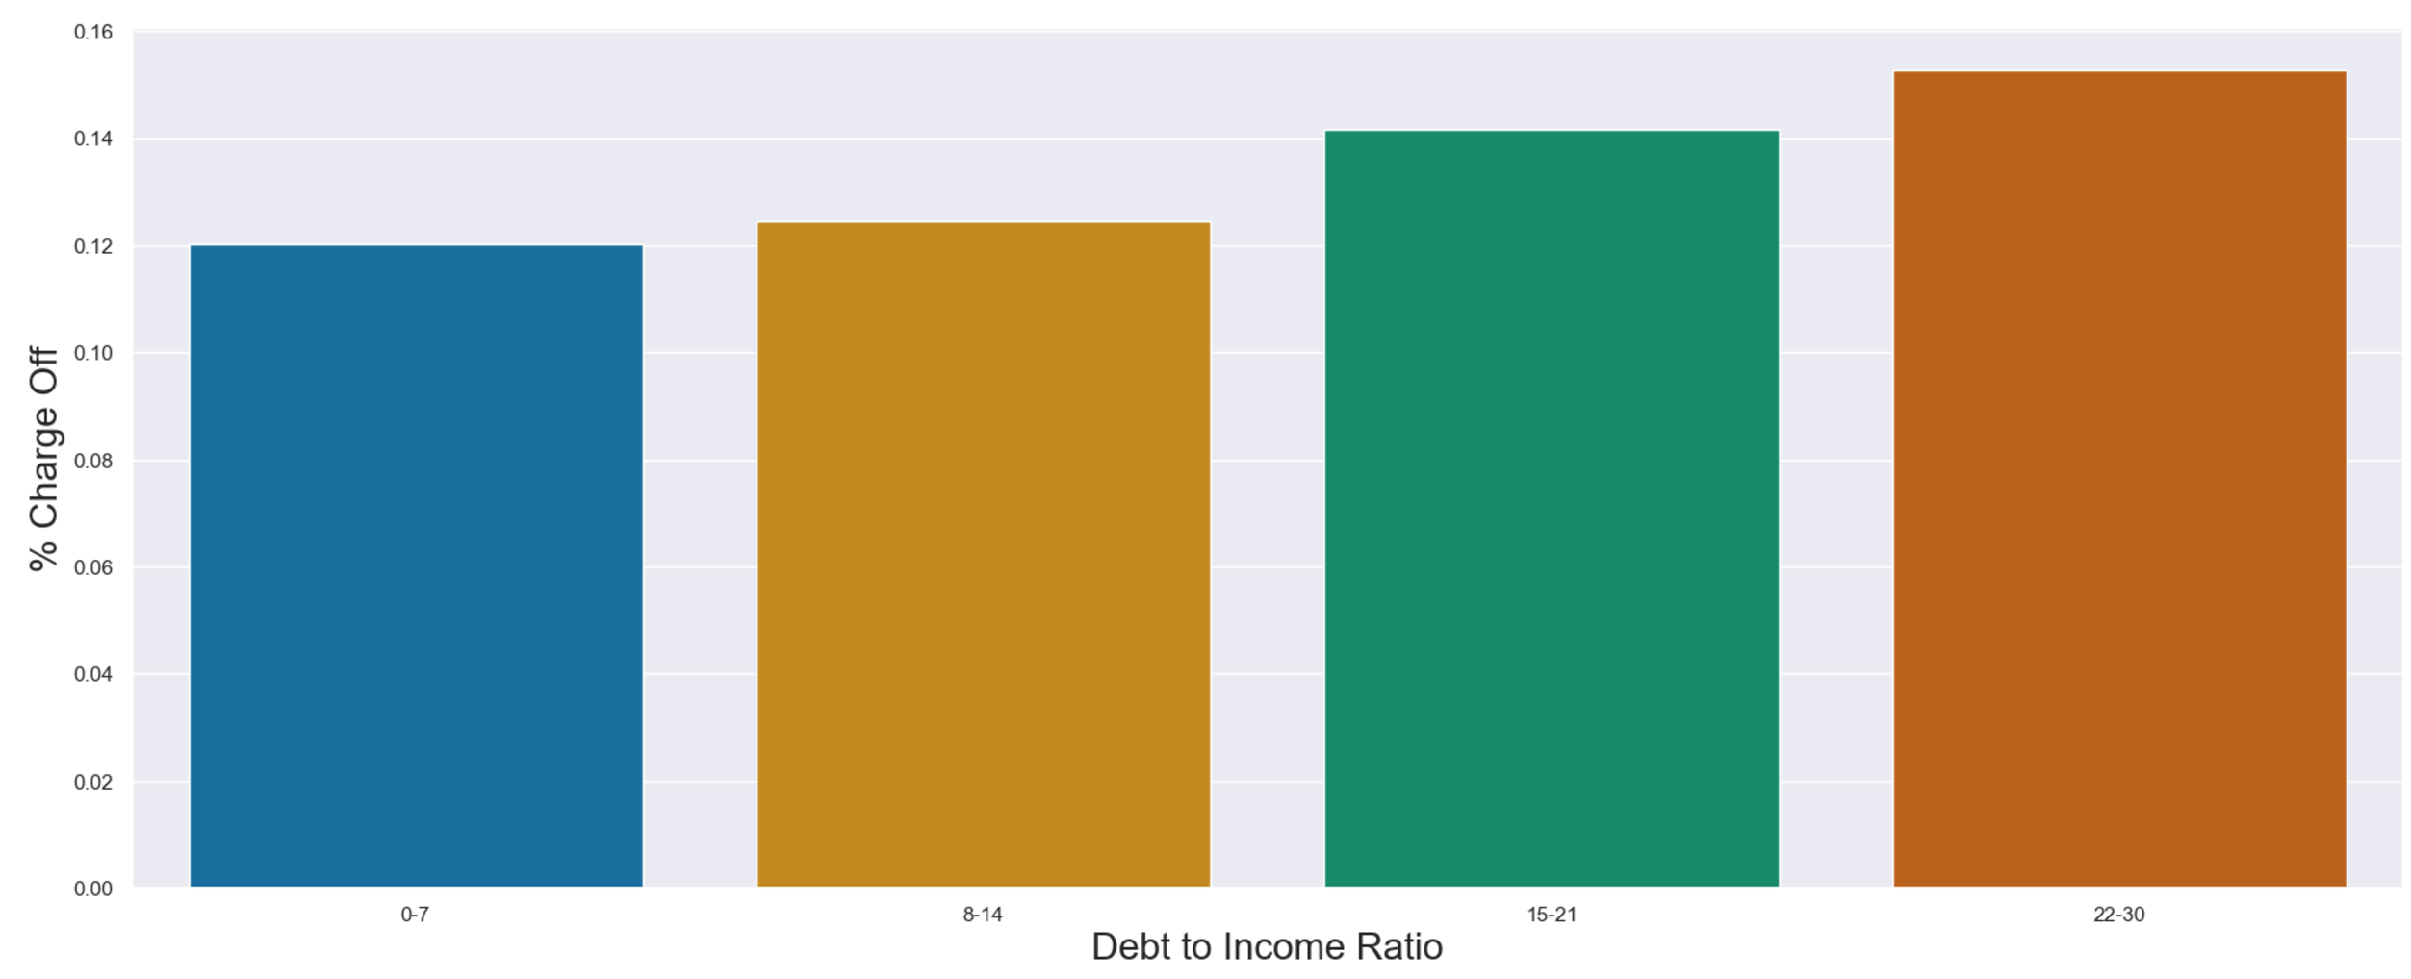
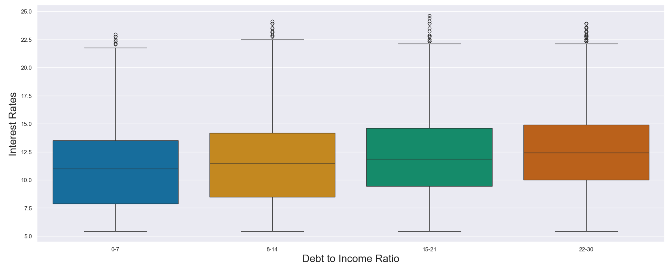
Debt to Income Ratio & Credit risk
Debt to Income Ratio is one of the key drivers for credit risk
A higher Debt to income ratio corresponds to a higher Default Rate, as is evident in the bar plot
Given that a higher DTI borrower is perceived riskier, we can see that the lending rate increases with an increase in the DTI, the least interest rate being offered to the lowest DTI bucket

Slide 13
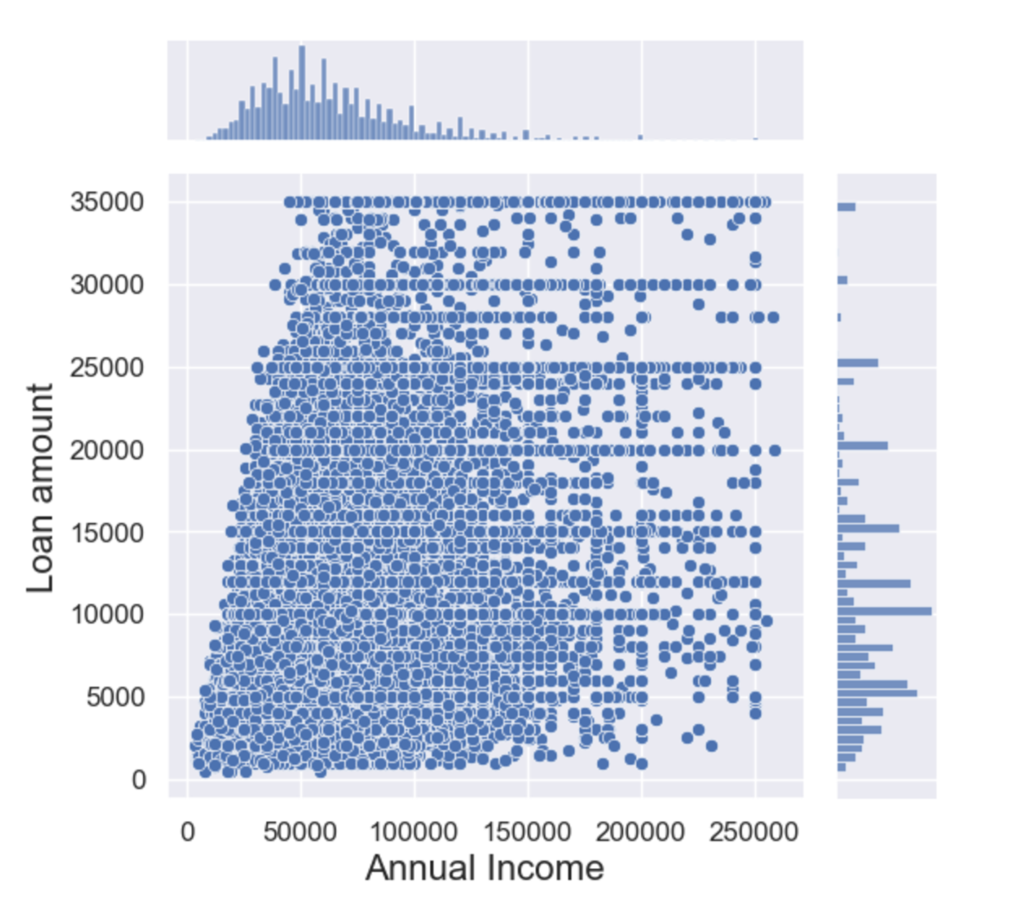
Joint distribution analysis : Loan amount & Annual income
We notice a few cases where the lender has extended high-value loans to low-income borrowers
For example, borrowers with annual income of less than 50,000 with approved loans of more than 25,000
Building on top of the analysis done so far, this increases the inherent risk in the portfolio
To reduce the risk of the portfolio, such cases should be avoided

Slide 14
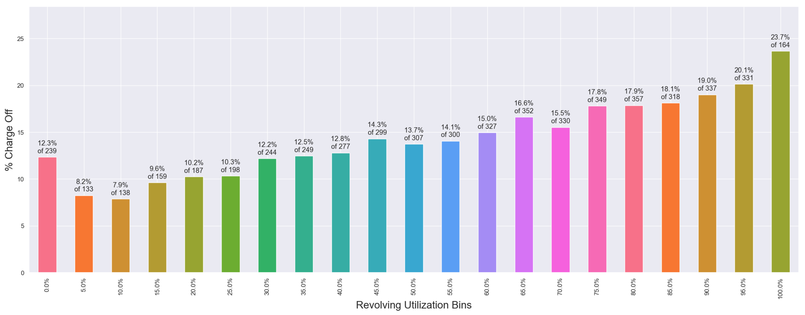
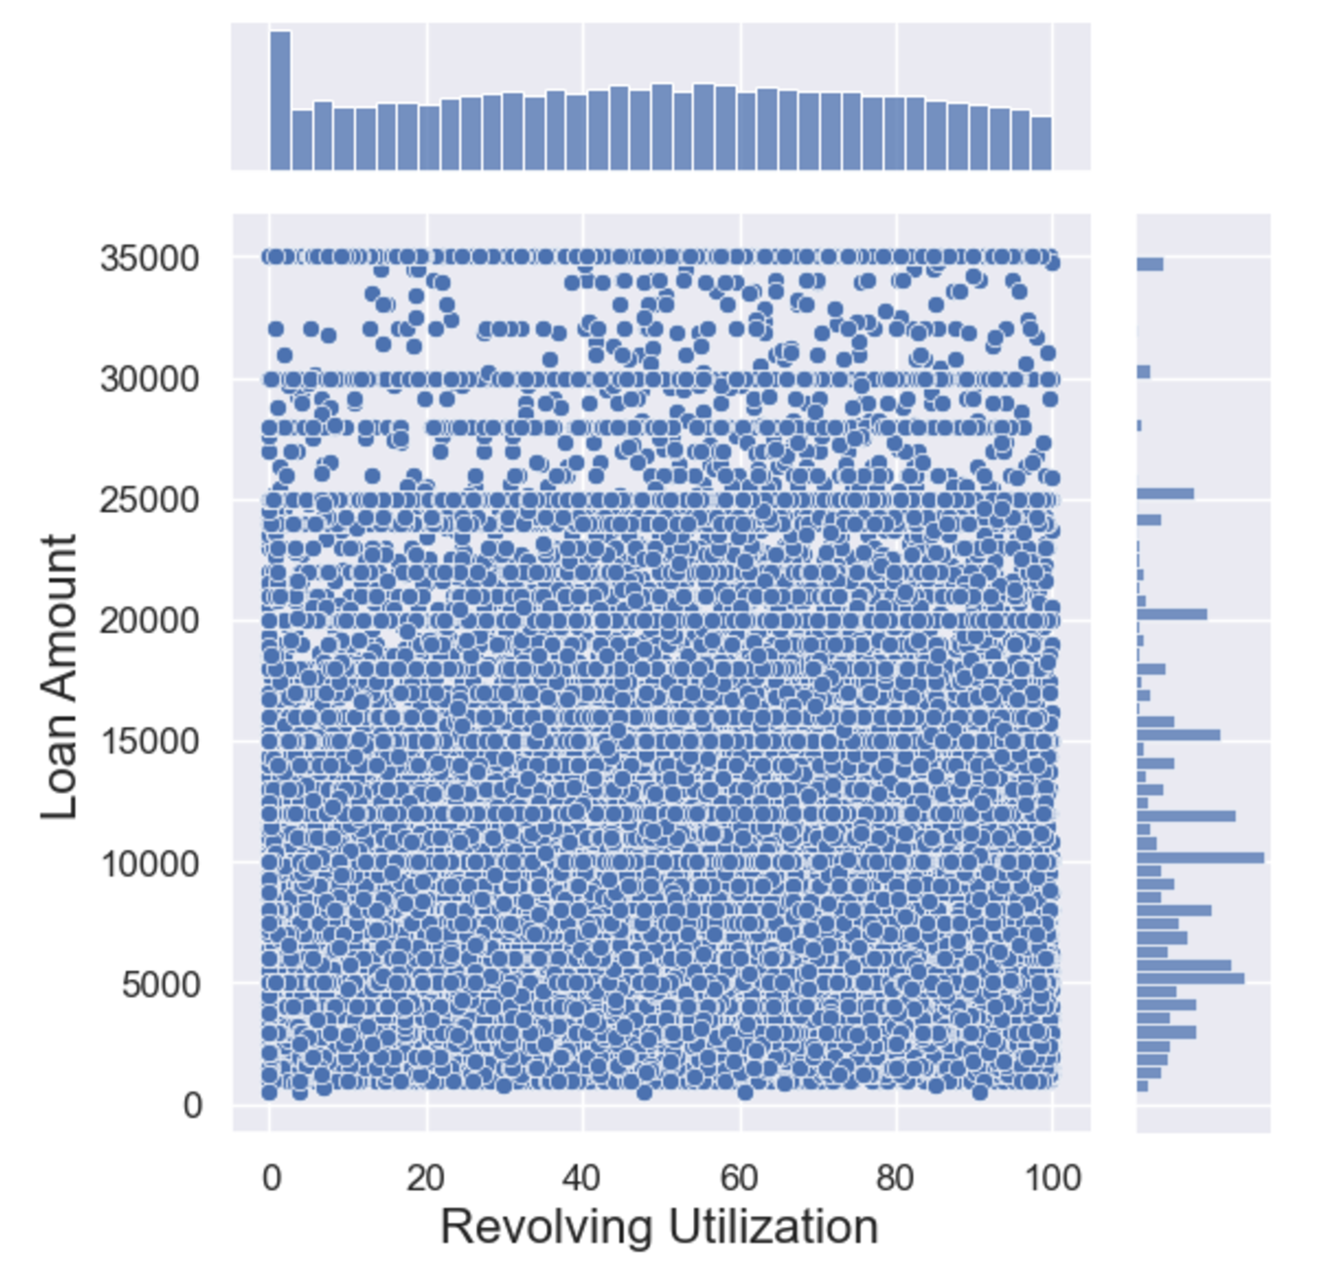
Utilization of revolving line of credit
Higher utilization of revolving line of credit are perceived more risky, as apparent in the higher default rate
We see high-value loans being approved to borrowers with revolving rate higher than 80%, this should be avoided to sanitize the inherent credit risk in the portfolio

Slide 15
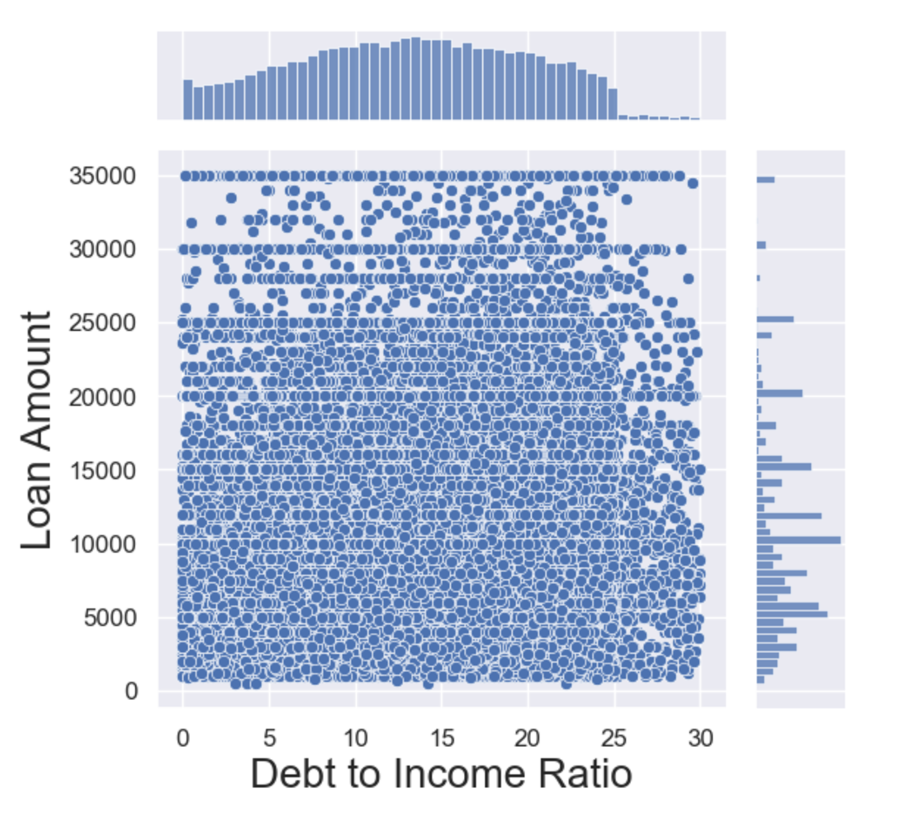
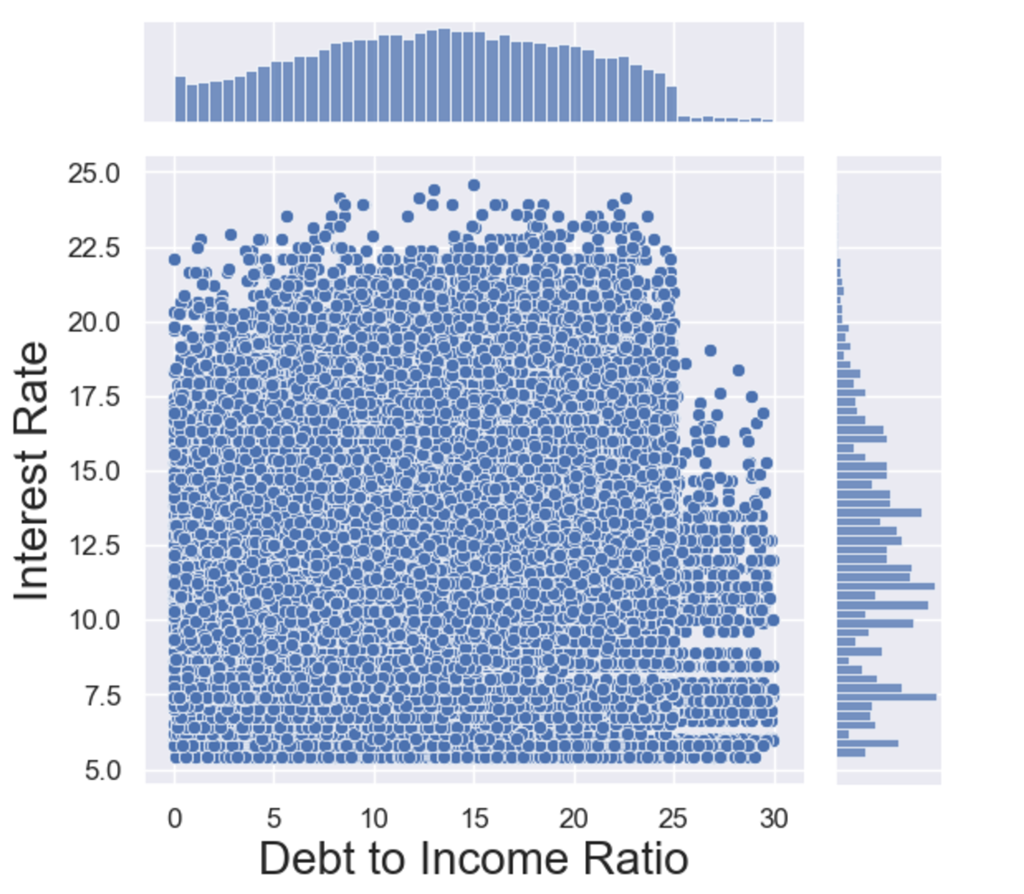
Joint distribution analysis : Loan amount/Interest Rate & Debt to Income Ratio
There are opportunities of reducing the credit risk of the portfolio by avoiding giving high value loans to borrowers with high Debt to Income Ratio. If at all, such borrowers are extended loans, they should be charged a higher interest rate as risk premium

Slide 16


Recommendations
Approving high-value loans to borrowers with Revolving Utilization more than 80%
Approving high-value loans being taken for Small-business purposes
STOP
Giving loans to people staying on loan or having mortgage
Approving loan amount in excess of 40% of the borrower’s annual income
AVOID
Charging higher interest rates from borrowers with high DTI, at least on high value loans
Approving more loans in less risky propositions like Wedding, car and home improvement
START

